Slide 1
Microsoft SQL Server
Optimize Data Workloads and Data Management

Slide 2
Links for this Session/Workshop
Scripts and Slide Decks https://github.com/db-berater/partitioning-for-beginners
ERP Demo Database (17.00 GB) https://db-berater.de/downloads/ERP_Demo_2012.bak
SQLQueryStress https://github.com/ErikEJ/SqlQueryStress
Windows Admin Center https://go.microsoft.com/fwlink/?linkid=2220149

Slide 3




Uwe Ricken db Berater GmbH
I am working with IT-systems since early 1990's and with the main focus on Microsoft SQL Server since version 6.0. I started with development of database applications in 1998 with a professional CRM-System based on Microsoft products (Microsoft Office and Microsoft SQL Server).
Since 2008 I'm focused exclusively on Microsoft SQL Server and working in 3rd level support teams for banks, insurances and global industries.
Since May 2013 I am a Microsoft Certified Master: SQL Server 2008 which was an amazing way into the depth of Microsoft SQL Server.
In July 2013 I have been awarded with the MVP Award for Microsoft SQL Server.
www: http://www.db-berater.de
email: uwe.ricken@db-berater.de
blog: http://www.sqlmaster.de
BlueSky: @sqlbambi

Slide 4
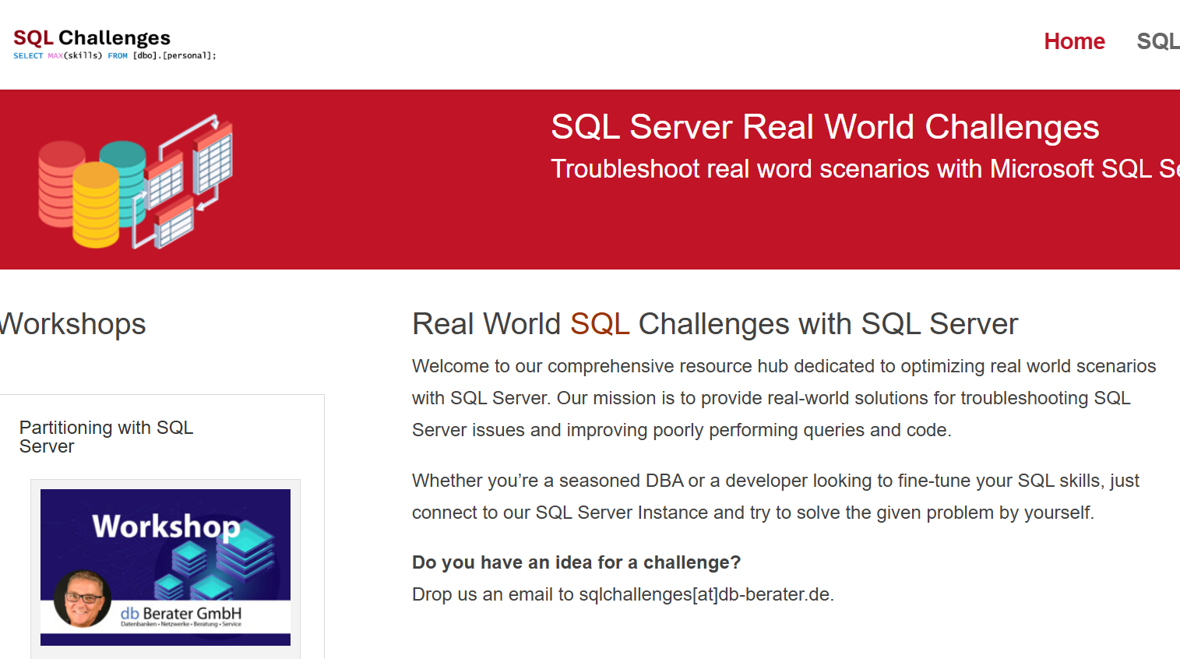
Challenge SQL Server real world scenarios
Get a challenge at least once a month
Connect to a provided SQL Server Instance
Load the challenge scenario
Try to solve it
Blog about your solution
Leave a link in the comments of the challenge to your blog post.
https://sqlchallenges.de

Slide 5
Note
All Use Cases described in this session are based on real-world scenarios and have found the implementation into production.
The customer scenarios have been simplified for this session.

Slide 6
Use Cases for Partitioning
High transactional production environment
The customer is a pharmaceutical company that produces drugs on various (16) production lines.
Every charge must go through a Q&A check that stores the data in the SQL Server Database.
Data Warehouse #1
The customer is a retail company that loads the key figures (product / sales) of all cash registers into the Date Warehouse every night so that they can create reliable plans for supplying the stores.
Data Warehouse #2
The customer is a bank that recalculates the valuation of its funds every night. During the calculation, the reports for BaFIN are already created for processed funds.
Management of big databases
A large company's administrator must re-create indexes and statistics from a 4TB database every night. The time window is limited, and a way must be found to limit maintenance to the time window.
Furthermore, the SLA determines a downtime for “hot” data within 60 Minutes!

Slide 7
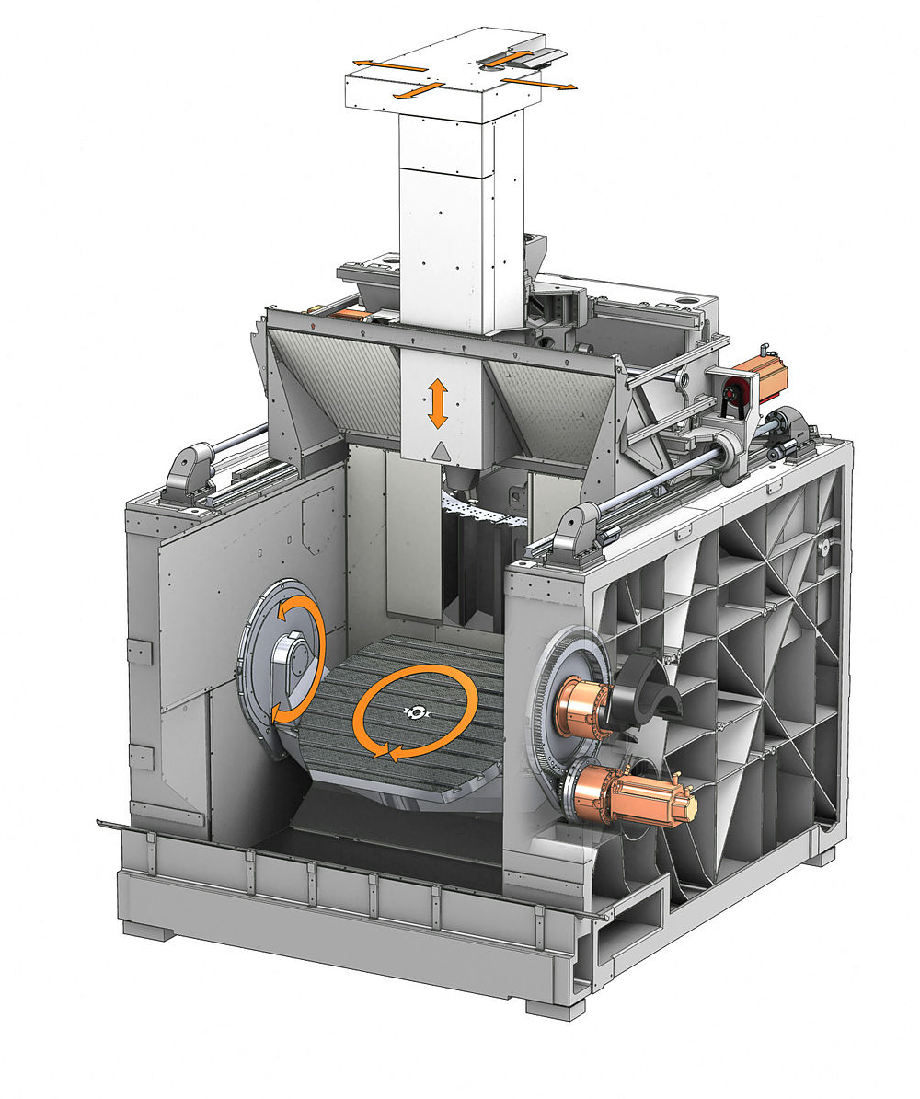


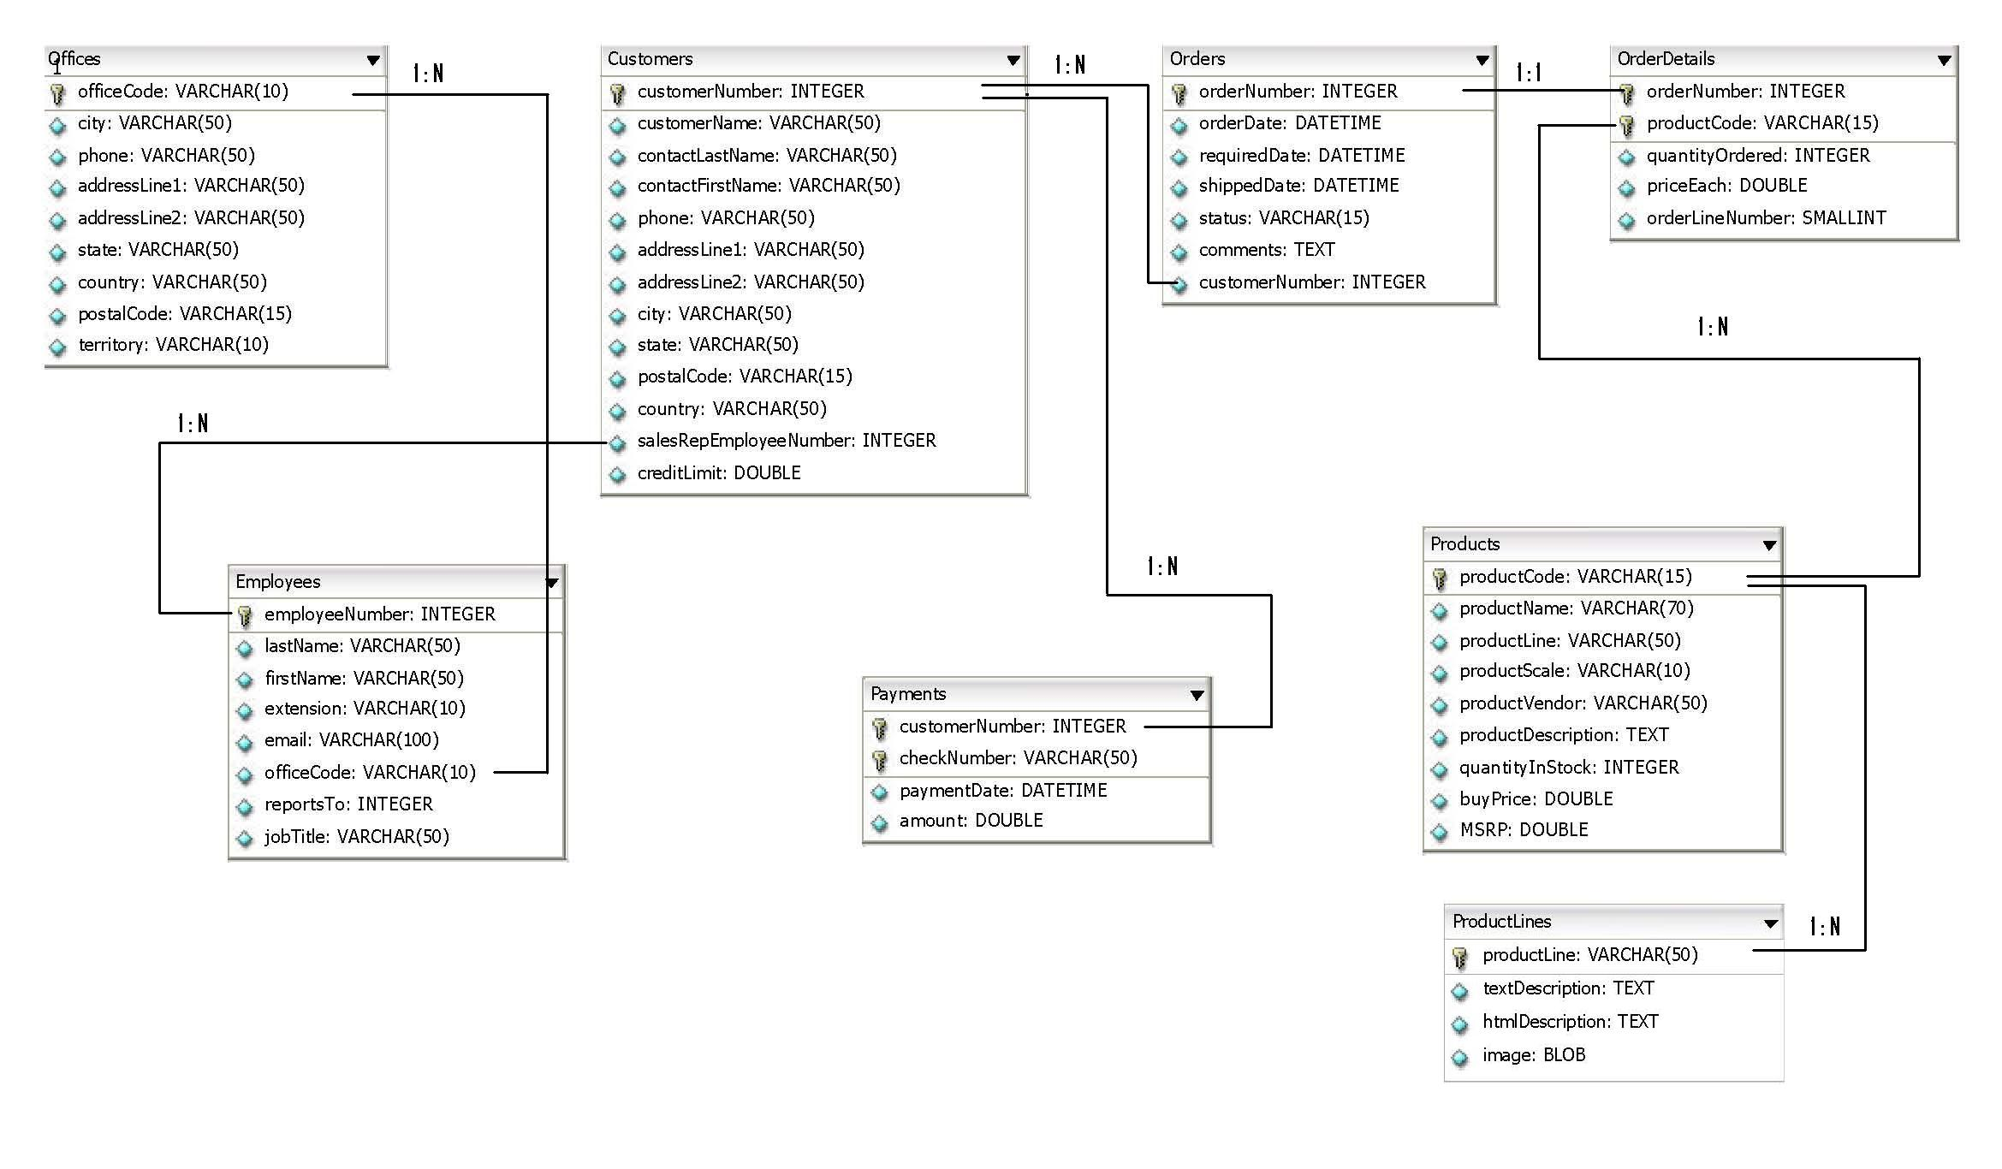
Use Case #1
…
Machine #1
Machine #2
Machine #15
Machine #16
X
INSERT DATA…
Webserver

Slide 8
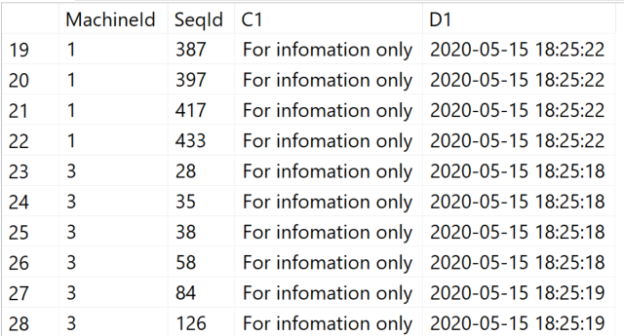
Use Case #1
PRIMARY
File
Write
Problems
The data in the queues grew because SQL Server could not save the data quickly enough!
LATCH-Contention was a problem because the database design could not scale.
Indexes were severely fragmented because the machine's ID was different with each process.

Slide 9
Demo / Hands On
Optimization of High Transactional System
0010 - speed up your high transactional workload.sql

Slide 10
Use Case #1
File
Machine_01
File
Machine_02
File
Machine_03
File
Distribution of data by machine
Reduced PAGELATCH_xx locking duration
Better throughput if data files are on different storage
No index fragmentation because every machine has its separate partition
Machine_15
File
Machine_16
Performance-Improvement: 3% – 15%

Slide 11
Use Cases for Partitioning
High transactional production environment
The customer is a pharmaceutical company that produces drugs on various (20) production lines.
Every charge must go through a Q&A check that stores the data in the SQL Server Database.
Data Warehouse #1
The customer is a retail company that loads the key figures (product / sales) of all cash registers / site into the Date Warehouse every night so that they can create reliable plans for supplying the stores.
Data Warehouse #2
The customer is a bank that recalculates the valuation of its funds every night. During the calculation, the reports for BaFIN are already created for processed funds.
Management of big databases
A large company's administrator must re-create indexes and statistics from a 4TB database every night. The time window is limited, and a way must be found to limit maintenance to the time window.
Furthermore, the SLA determines a downtime for “hot” data within 60 Minutes!

Slide 12
Data Warehouse #1
Calculations on warehouse data are not possible while data from OTHER warehouses are importing.
No parallel execution of the import possible. The customer sees an increasing time for import for each process.
W1
C1
W2
C1
W3
C1
W10
C1
W1
C5
W2
C2
W3
C1
W9
C1
W1
C9
W2
C7
W5
C1
BULK LOAD…
W100
C1
W1
C…
W1
C9
W7
C1
FTP-Server
DB-Server
W150
C1

Slide 13
Data Warehouse #1
.csv
SCHEMA: staging
SCHEMA: dbo
staging.raw_data
Clustered Index:
warehouse_Id,
cash_Id
~13.000.000 rows
~800.000 rows / warehouse_id
dbo.sales_figures
Clustered Index:
Import_date, (Part),
warehouse_Id,
cash_Id,
article_id
~650,000 rows / warehouse
.csv
.csv
dbo.ImportWarehouseData
.csv
.csv

Slide 14
Data Warehouse #1
Lock Escalation prevented data records from being entered into the table at the same time
Only when the blocking process releases the lock can the next process write to the table!
Partitioning only works in this scenario if the LOCK_ESCLATION = AUTO option is activated for the table.
X-LOCK
SPID: 53
SPID: 54
SPID: 54
SPID: 56
SPID: 57

Slide 15
Use Cases for Partitioning
High transactional production environment
The customer is a pharmaceutical company that produces drugs on various (20) production lines.
Every charge must go through a Q&A check that stores the data in the SQL Server Database.
Data Warehouse #1
The customer is a retail company that loads the key figures (product / sales) of all cash registers into the Date Warehouse every night so that they can create reliable plans for supplying the stores.
Data Warehouse #2
The customer is a bank that recalculates the valuation of its funds every night. During the calculation, the reports for BaFIN must be created for processed funds because of timeline restrictions.
Management of big databases
A large company's administrator must re-create indexes and statistics from a 4TB database every night. The time window is limited and a way must be found to limit maintenance to the time window.
Furthermore the SLA determines a downtime for “hot” data within 60 Minutes!

Slide 16
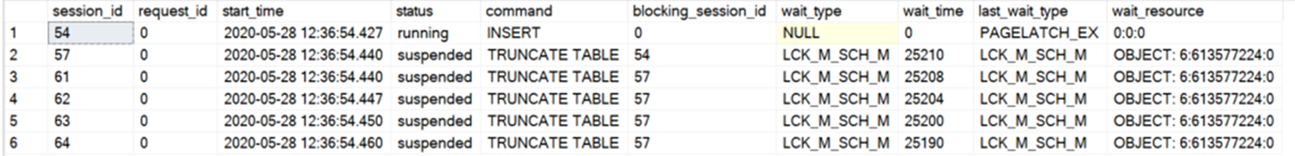
Data Warehouse #2
Problems
TRUNCATE TABLE WITH (PARTITION) causes LCK_M_SCH_M on table
Other processes have to wait when one process inserts data. The INSERT process holds an LCK_IX lock on the table
An LCK_IX lock is incompatible with an LCK_M_SCH_M lock

Slide 17
Data Warehouse #2
Partition (staging)
Fonds_001
Fonds_002
Fonds_003
…
…
…
Fonds_150
dbo.FondsCalculation
Partition_001
Partition_002
Partition_003
…
…
…
Partition_150
ALTER TABLE [source]
SWITCH PARTITION #
TO dbo.FondsCalculation PARTITION #;
Daily transactional activity for each fonds

Slide 18
Use Cases for Partitioning
High transactional production environment
The customer is a pharmaceutical company that produces drugs on various (20) production lines.
Every drug has to go through a QA check that stores the data in the SQL Server.
Data Warehouse #1
The customer is a retail company that loads the key figures (product / sales) of all cash registers into the Date Warehouse every night so that they can create reliable plans for supplying the supermarkets.
Data Warehouse #2
The customer is a bank that recalculates the valuation of its funds every night. During the calculation, the reports for BaFIN must be created for processed funds because of timeline restrictions.
Management of big databases
A large company's administrator must re-create indexes and statistics from a 4TB database every night. The time window is limited and a way must be found to limit maintenance to the time window.
Furthermore the SLA determines a downtime for “hot” data within 60 Minutes!

Slide 19
Common SLAs for DBAs
Recovery Point Objective (RPO)
Recovery Time Objective (RTO)
Recovery Level Objective (RLO)
Notes:
The most common place where we see well defined SLAs when dealing with Microsoft SQL Server is in the area of High Availability and Disaster Recovery. These SLAs tend to be easier to define as there are set times and measurable. For HA/DR, the three key SLAs are Recover Point Objective (RPO), Recover Time Objective (RTO), and Recover Level Objective (RLO). We will use HA/DR to define some SLAs that can then be used as example to be used in other areas of database administration. Two other key areas for defining SLAs are Database/Application Performance and Security/Compliance.

Slide 20
Consideration with big databases
Is it required to backup the complete database every night?
How long does the backup take?
How much storage does it consume?
Will differential backups help?
Why not run backups against „hot“ and „changing“ data?
Use partitioning for the read-write filegroups
Same questions come up for RESTORE!!!
Can a full restore of the database cover the SLA?
Partitioning can boost the restore by restoring only read-write filegroups
Restore read-only filegroups later

Slide 21
Filegroup Restore
 |  |  | dbo.CustomerOrders
2020 | … | … | … | … | … | … | … | … | …
2019 | … | … | … | … | … | … | … | … | …
2018 | … | … | … | … | … | … | … | … | …
PartitionFunction()
2000
…
…
…
2016
2017
2018
2019
2020

Slide 22
Filegroup Restore
 |  |  | dbo.CustomerOrders
2020 | … | … | … | … | … | … | … | … | …
2019 | … | … | … | … | … | … | … | … | …
2018 | … | … | … | … | … | … | … | … | …
PartitionFunction()
2000
…
…
…
2016
2017
2018
2019
2020

Slide 23


Session Feedback💖
https://bit.ly/dMC2022_SessionFeedback

Slide 24
THANK YOU!
I am looking forward for your feedback!
Uwe Ricken

